Slide 1
BUREAU OF BLINDNESS AND VISUAL SERVICES
Promoting Independence for Pennsylvanians with Vision Loss

Slide 2
WHO WE ARE
The Bureau of Blindness and Visual Services (BBVS) is a Bureau under the Office of Vocational Rehabilitation (OVR), Department of Labor and Industry, Commonwealth of Pennsylvania

Slide 3
WHO WE ARE
BBVS Services are provided throughout the Commonwealth by six district offices. The BBVS Central Office for administrative operations is located at:
1521 N. Sixth St.
Harrisburg, PA 17102
1-800-622-2842
1-866-830-7327 TTY

Slide 4
DISTRICT OFFICE LOCATIONS AND COUNTIES SERVED
Altoona BBVS
1130 12th Ave. Suite 300
Altoona, PA 16601
1-866-695-7673
1-866-320-7956 TTY
FAX 814-949-7995
Bedford, Blair, Cambria, Centre, Clinton, Columbia, Fulton, Huntingdon, Juniata, Lycoming, Mifflin, Montour, Northumberland, Snyder, Somerset, Union
Erie BBVS
4200 Lovell Place
Erie, PA 16503
1-866-521-5073
1-888-884-5513 TTY
FAX 814-871-4746
Cameron, Clarion, Clearfield, Crawford, Elk, Erie, Forest, Jefferson, Lawrence, McKean, Mercer, Potter, Venango, Warren

Slide 5
DISTRICT OFFICE LOCATIONS AND COUNTIES SERVED
Harrisburg BBVS
Forum Place
555 Walnut St., 8th Floor
Harrisburg, PA 17101
1-866-375-8264
1-888-575-9420
FAX 717-772-0589
Adams, Cumberland, Dauphin, Franklin, Lancaster, Lebanon, Perry, York
Philadelphia BBVS
444 North 3rd St., 5th Floor
Philadelphia, PA 19123
1-866-631-3892
1-888-870-4473 TTY
FAX 215-965-4873
Bucks, Chester, Delaware, Montgomery, Philadelphia

Slide 6
DISTRICT OFFICE LOCATIONS AND COUNTIES SERVED
Pittsburgh BBVS
531 Penn Ave.
Pittsburgh, PA 15222
1-866-412-4072
1-877-255-5082 TTY
FAX 412 565-2296
Allegheny, Armstrong, Beaver, Butler, Fayette, Greene, Indiana, Washington, Westmoreland
Wilkes-Barre BBVS
300 G Laird St.
Wilkes-Barre, PA 18702
1-866-227-4163
1-888-651-6117 TTY
FAX 570-826-2538
Berks, Bradford, Carbon, Lackawanna, Lehigh, Luzerne, Monroe, Northampton, Pike, Schuylkill, Sullivan, Tioga, Wayne, Wyoming

Slide 7
Bureau of Blindness and Visual Services Mission
The mission of BBVS is to assist Pennsylvanians who are blind or visually impaired to work and maintain independent lives.
BBVS provides services to Pennsylvanians of all ages experiencing vision loss.

Slide 8
Eligibility for Services
There are two criteria used to establish eligibility for BBVS Services:
Visual eligibility
Assessment of need for services

Slide 9
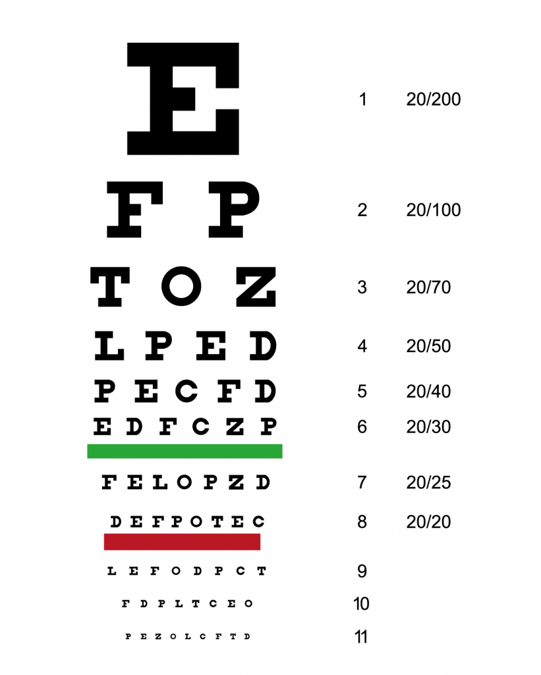
Visual Eligibility

Slide 10
Visual Eligibility
Based on one or more of these four factors:
A corrected visual acuity of 20/70 or greater loss in the better eye
A visual field loss of 20 degrees or greater
A diagnosis of a progressive sight threatening disease
A significant functional limitation from vision loss

Slide 11
Visual Eligibility: Functional Limitations

Slide 12
Visual Eligibility (continued)
Must receive documentation of visual diagnosis. Can be obtained from customer’s:
Ophthalmologist, optometrist, or physician
Social Security Disability Determination Unit

Slide 13
Eligibility: Assessment of Need
An assessment of need for service must be completed.
Assessment identifies significant functional limitations in completing daily living tasks that result from vision loss and determines what services the individual needs to maintain an independent life.

Slide 14
Financial Eligibility
Certain services require the completion of a Financial Needs Test (FNT)
The FNT is based on income guidelines established by the federal government.
Comparable benefits must be used when applicable

Slide 15
Referral/Application Process
Referral received, case file created, case placed on a master list to await investigation.
Referral is assigned to appropriate program
Letter acknowledging referral sent to the individual with a release of information form to obtain an eye report to establish visual eligibility.
The Social Worker or Vocational Rehabilitation Counselor assigned to the case then contacts the individual to set up an appointment for an initial interview
Initial interview-SW completes assessment including impact of vision loss on functional capabilities; eligibility criteria discussed; available services discussed and community resources; application completed

Slide 16
PLAN FOR SERVICES
Development of plan can only occur after eligibility is established, and the assessment of needs and application are completed.
Social worker and customer work together to develop plan
Plan contains description of customer’s goals, description of services to be provided by BBVS and other agencies
Plan is a blueprint of those rehabilitative services to be provided with the end goal of promoting the individual’s independence.

Slide 17
Overview of BBVS Programs
To accomplish our mission statement, BBVS provides rehabilitation services through the following programs:
Vocational Rehabilitation Program (VR)
Randolph-Sheppard Business Enterprise Program (BEP)
Independent Living Older Blind Program
Special Services for Children Program
Specialized Services for Adults Program
Instructional Services: Rehabilitation Teaching & Orientation and Mobility Training

Slide 18
Vocational Rehabilitation Program
Helps individuals prepare, enter into or retain employment
Services offered under this program can include but are not limited to:
Counseling and guidance
Adjustment to blindness
Vocational Evaluation
Vocational and college training
Assistive technology
Rehabilitation Teaching
Orientation and Mobility Instruction
Occupational tools and equipment
Job placement services
Pre – Employment Transition Services

Slide 19
Vocational Rehabilitation Program (continued)
Services are based on individual’s needs and choices, and some or all of these services may be needed for the person to prepare for, enter into or retain employment
VRCs work directly with an individual to determine an appropriate employment goal and what services are needed to reach that goal.
An Individual Plan for Employment (IPE) is developed jointly by the counselor and customer

Slide 20
Randolph Sheppard-Business Enterprise Program (BEP)
The Randolph-Sheppard BEP assists persons in the operation of food service business in commercial, industrial or government locations.
Food Service businesses can range from a vending machine route to the management of a large cafeteria.
Eligible persons enter this program through the BBVS VR Program.
BBVS BEP Agents are available and provide ongoing technical support.

Slide 21
Specialized Services Program (SS)
SS Program assists individuals to become more self-sufficient and independent in their homes and communities.
Two components to this program:
SS Adult: serves adults up to 54 years of age who are not candidates for VR Program. Services provided are similar to those under the ILOB program; will be described in detail in successive slides.
SS-Children: serves children from birth to age 21 and their families.

Slide 22
Specialized Services for Children Program (Birth to 18 years of age)
A BBVS Social Worker works with the child and their family to provide the following services as needed:
Adaptive equipment
Advocacy for educational services
Low vision services
Rehabilitation Teaching
Counseling and guidance
Community Orientation and Mobility instruction
Children’s summer programs
Transition services (assisting the student with transition from school to post-secondary education or employment by coordinating with BBVS VRC)

Slide 23
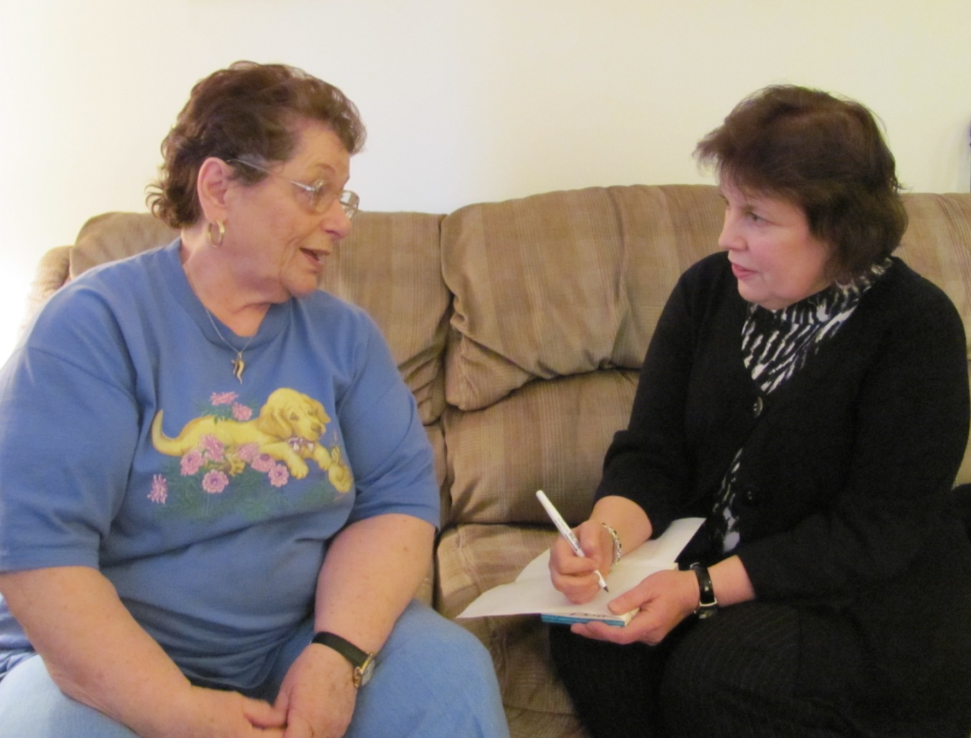
Independent Living Older Blind Program

Slide 24
Independent Living Older Blind Program (ILOB) Age 55+
Purpose of program: to provide rehabilitation services to enable individuals to regain or maintain maximum independence in their homes and communities.
A BBVS Social Worker after receiving a referral contacts the customer , establishes eligibility, assesses their needs and develops a Service Plan with them which identifies the services to be provided.

Slide 25
ILOB Program (continued)
Services can include:
Information and referral service- the direct provision of information about services including appropriate community resources.
Counseling and guidance-BBVS Social Worker helps customer and their families adjust to blindness by listening, educating them about vision impairment and other independence issues, explores resources, discusses options and provides information about support groups.

Slide 26
ILOB Services (continued)
Advocacy Services-Social Worker may be involved in teaching self-advocacy skills to empower customers to advocate for themselves
Diagnostic Services-Can be provided to determine visual eligibility; can include eye exams

Slide 27
ILOB Services (continued)
Low vision Services
BBVS Social Worker purchases low vision services from an Optometrist trained in the specialty of low vision.

Slide 28
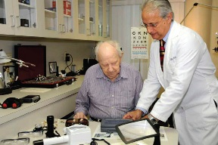
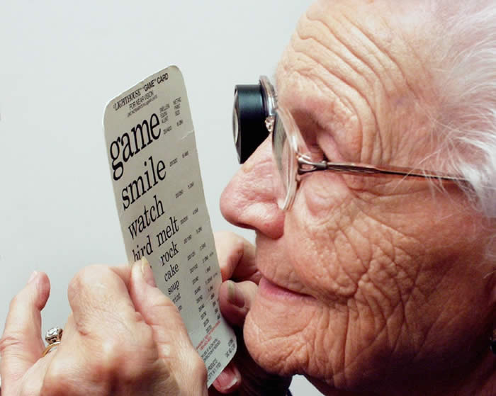
Low Vision Evaluation

Slide 29
ILOB Services (continued)
Purpose of LVE is to prescribe optical and non-optical aids that assist the customer in maximizing the use of their residual vision.
Low vision aids include high powered glasses, magnifiers, telescopic devices, electronic devices, special lighting or glare filters.

Slide 30
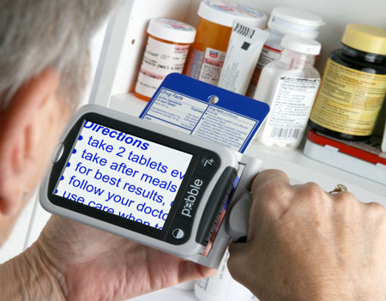
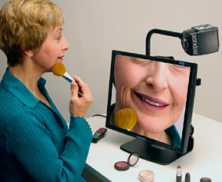
Low Vision Aids

Slide 31
ILOB Services (continued)
Hearing Aids
Goal of providing a hearing aid is to reduce isolation by enabling verbal communication or to enable the customer to remain independent.
Particularly when a documented hearing loss poses a threat to safety such as the recognition of environmental sounds and speech discrimination necessary for safe travel
Hearing aid may be purchased as part of customer’s plan.

Slide 32
ILOB Services (continued)
Access Technology
Different types of speech or large print software are available to allow the customer with vision loss to access their computer.
BBVS can pay for up to $2000 for this software
Cannot purchase personal computers, upgrades or hardware
Access technology assessment must be completed
Maximum of 10 hours training may be provided

Slide 33
ILOB Services (continued)
Instructional Services-
Rehabilitation Teaching (RT)
Orientation and Mobility Instruction (O&M):
Provided by teachers on staff with BBVS
No fee for training or recommended adaptive equipment

Slide 34
Rehabilitation Teaching Program
Instruction in adaptive equipment and techniques is provided to help individuals safely and efficiently perform their daily living activities at home, on the job and in the community.
A comprehensive evaluation is completed by a trained teacher and a plan is developed with the customer

Slide 35
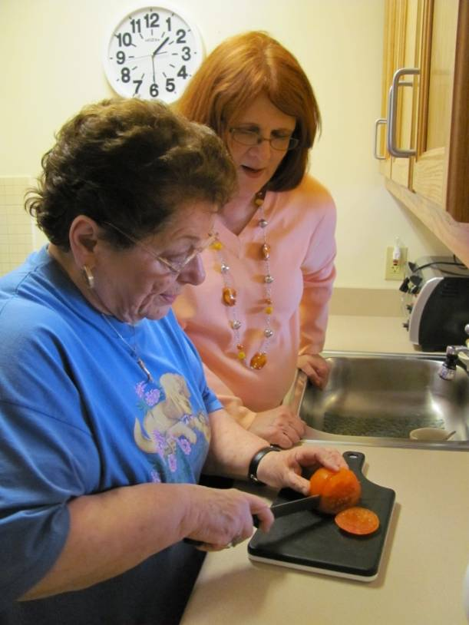
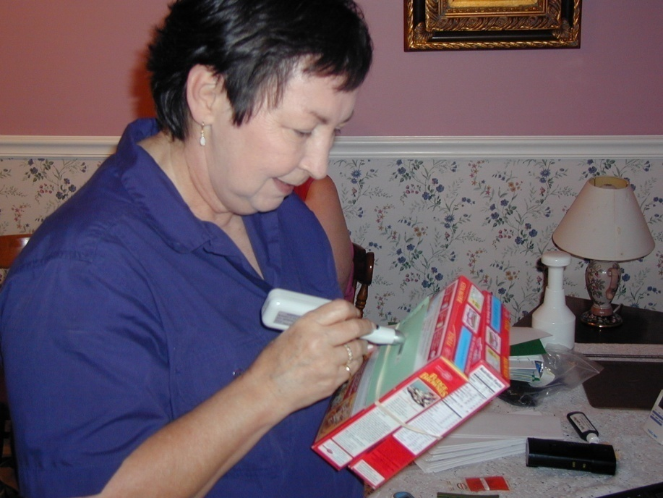
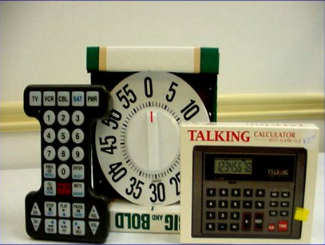
Rehabilitation Teaching

Slide 36
Rehabilitation Teaching (continued)
Training may include instruction in adaptive techniques for:
Personal management skills such as grooming and hygiene, clothing care, medication management , time and money management
Home management skills such as using appliances, food preparation and cooking, eating and dining skills, laundry, cleaning, sewing, home maintenance and repair

Slide 37
Rehabilitation Teaching (continued)
Communication Skills such as using the telephone, writing, recording and listening devices, and Braille
Access Technology such as keyboarding and adaptive software
Orientation to immediate home environment

Slide 38
Orientation and Mobility Instruction (O&M)
O&M training teaches individuals how to travel independently and safely within their homes, workplaces and the community
A BBVS professional instructor provides individualized training
After evaluation is completed by the instructor, an instructional services plan is developed with customer to meet their specific needs

Slide 39
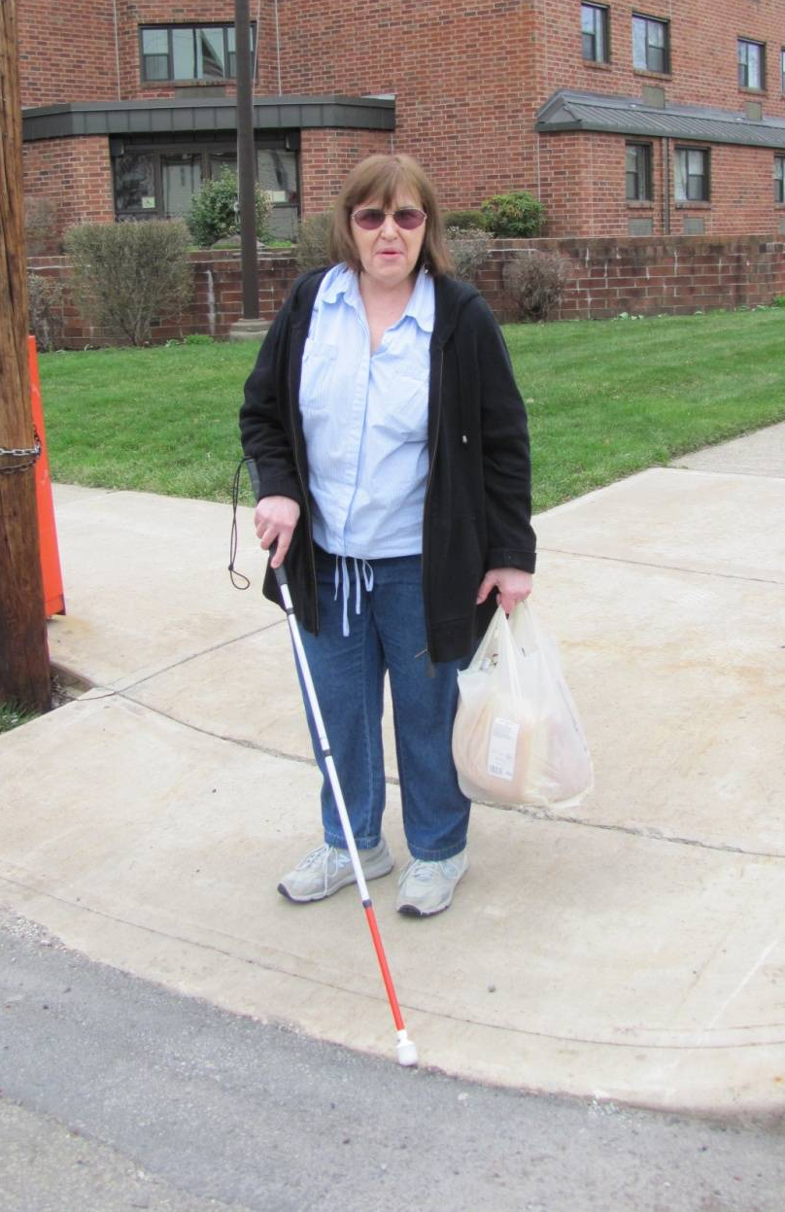
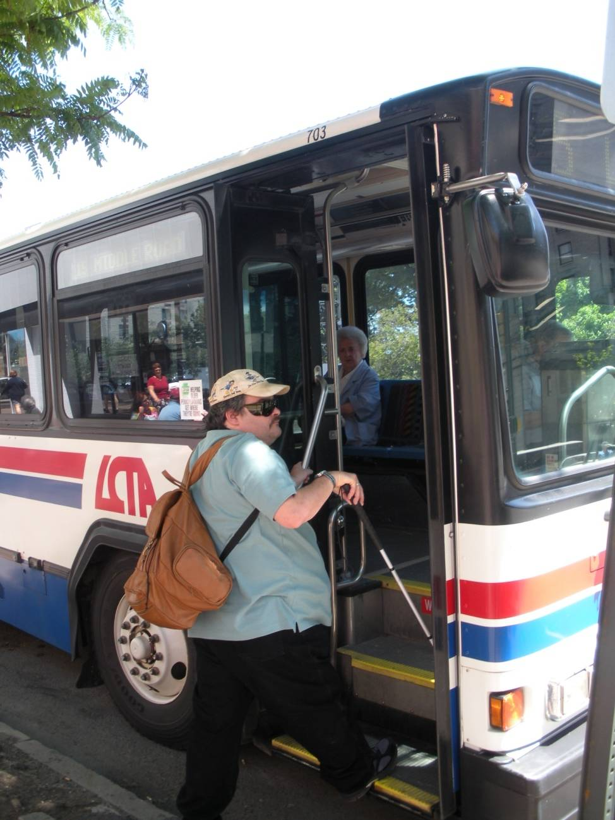
Orientation and Mobility Instruction

Slide 40
O&M Instruction
Individual instruction with customer is initiated and may included:
Provision of an adaptive mobility tool such as the red/white cane and instruction in techniques for use
Preparation for, referral and follow-up training for a guide dog
Instruction in the development and use of all senses for orientation

Slide 41
O&M Instruction
Incorporation of low vision aids in instruction
Provide information and assist in making application to alternate transportation resources and provide one on one instruction in their use
Instruction in techniques for independent travel in a variety of environments
Instruction in techniques for intersection analysis and negotiation

Slide 42
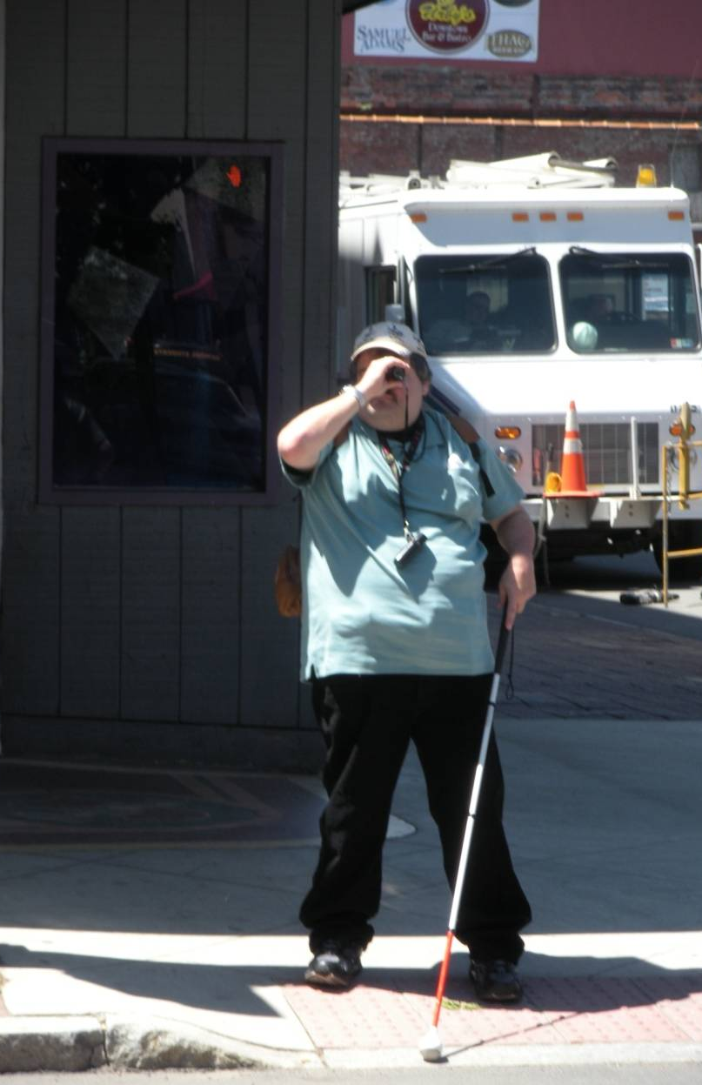
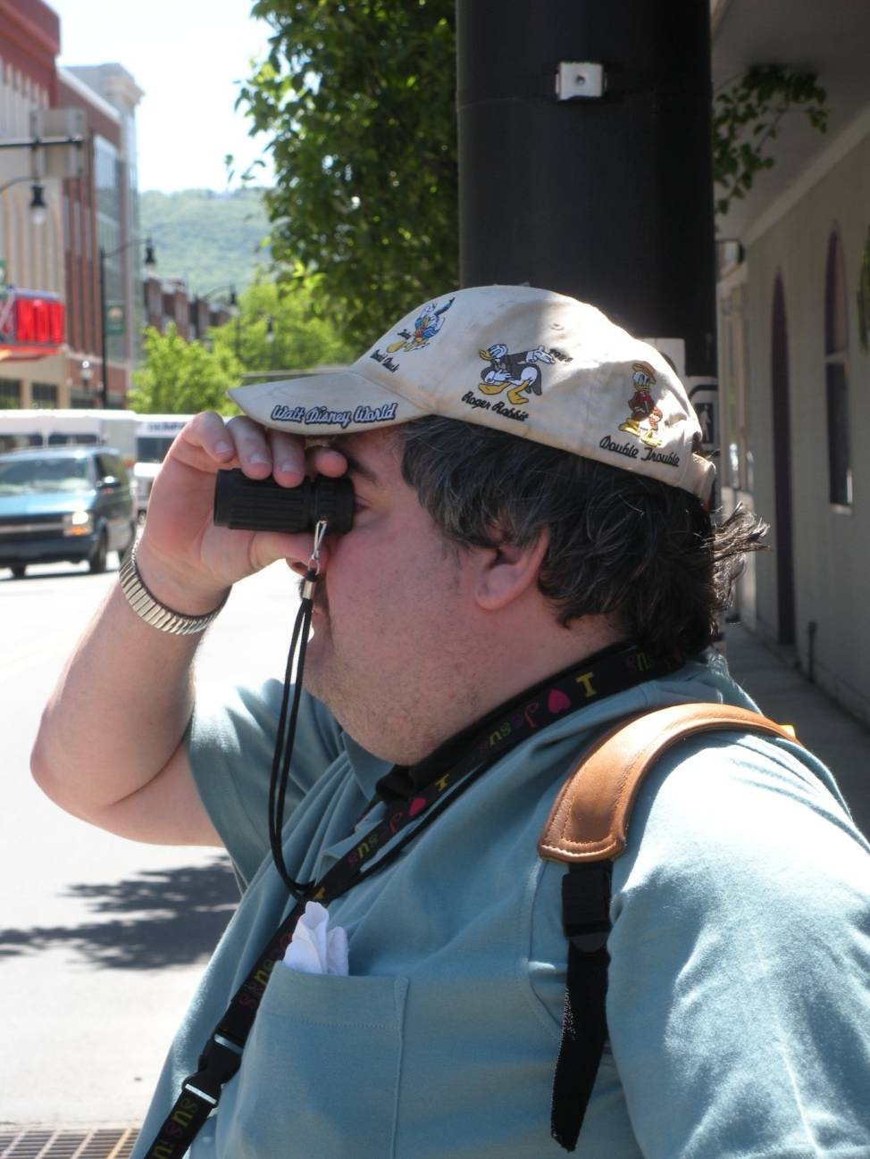
O&M Instruction

Slide 43
Services to Residents of Nursing Homes
BBVS can provide outreach and education services to facilities.
Minimum training is provided to familiarize nursing home staff on how to refer residents for a low vision evaluation and/or other services such as talking books from the Library for the Blind and Physically Handicapped.

Slide 44
Services to Residents of Assisted Living, Personal Care Homes and Group Homes
Comprehensive BBVS services can be provided to those residents who are blind or experiencing vision loss to maximize their independence.
It should be noted that comprehensive services can be provided to a resident of a nursing home if the facility is providing temporary rehabilitative services prior to the resident being discharged into a community setting.

Slide 45
Case Closure
After all services as outlined in the Independent Living/Specialized Services Plan have been provided and all goals have been met to the mutual satisfaction of the customer and Social Worker the case is then closed.
Before the case is closed the customer is contacted to discuss closure of the case and if all objectives have been satisfied and how the customer has benefited from services.
In addition a letter informing the customer of the case closure is sent along with information on their right to appeal and this process.

Slide 46
Referral to BBVS for Services
Thank you for your interest in Pennsylvania Office of Vocational Rehabilitation (OVR) services. OVR’s mission is to assist individuals with disabilities to secure and maintain employment and independence. To initiate a referral for OVR services, you can complete and submit an online “OVR Pre-Application” via the Pennsylvania CareerLink (PA CareerLink) website using the instructions below.
https://www.pacareerlink.pa.gov/

