Slide 1

Transition 101
Your Plan, Your Future
Brian Kritzer
Educational Consultant, M. Ed.
Tuscarora Intermediate Unit 11
bkritzer@tiu11.org

Slide 2

Today’s Learning Outcomes
Define transition in general terms then apply it to an Individualized Education Plan (I.E.P.)
Know who can assist with transition planning
Understand self-determination and how to participate in an IEP meeting
Learn about transition related websites
Understand the impact transition planning has on the future

Slide 3
First Lets define transition
Webster’s Dictionary - passage from one state, stage, subject, or place to another; change
Life in general is full of change.
There are a board range of emotions that you can feel when you experience change. (excitement, joy, fear, stress, frustration, etc.)

Slide 4










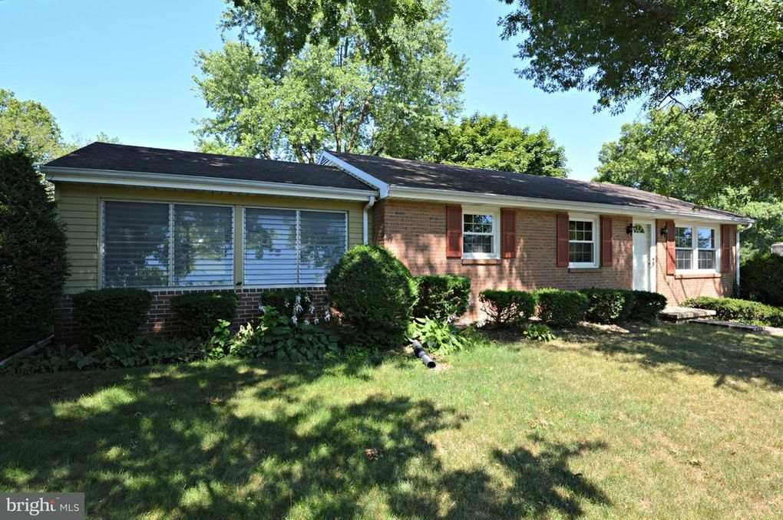
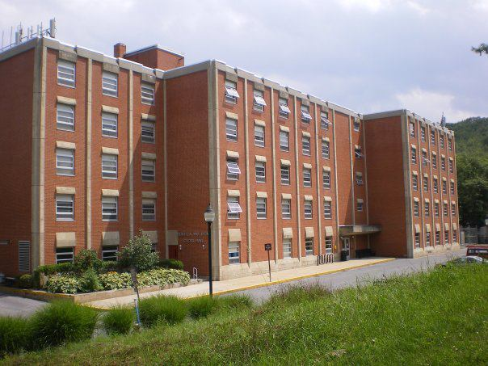
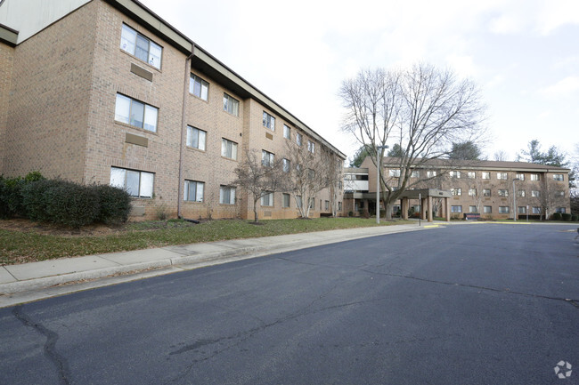
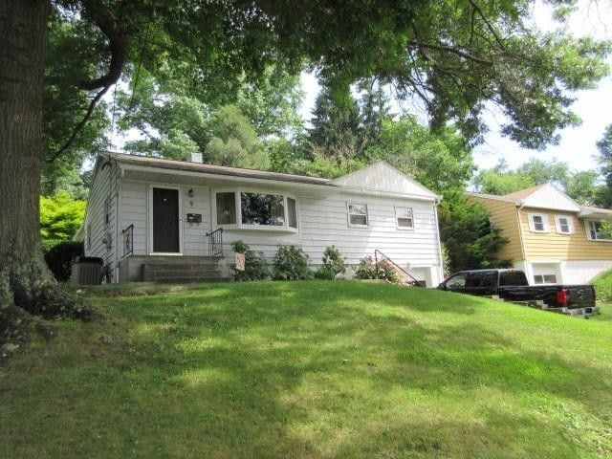
School/Work/Living Transitions –
This Tells My Story

Slide 5
what does your future look like?
What are some transition you have made so far in your life? These can be big or small.
  How have these changes been?
What transition do you envision happening in your future in the areas of school, work, and everyday life? Things to consider…
  Where to live
  Who to live with
  What to do as a job
  What to do in their free time
  How to make friends and have relationships

Slide 6

I’m not sure what My Future will look Like!
It’s okay not to know!
The school is there to help you figure this out.
When you turn 14 years old, or sooner if you would like, the school will begin to support and prepare you for life after graduation through the transition component of your Individualized Education Plan (I.E.P.)
Who will be helping me?
  Anyone that wants to but more specifically - special education teacher or transition coordinator, guidance councilor, parents, and outside agencies

Slide 7

The importance of Your Meeting –
You decide your future!
There are usually several people at your IEP meeting.
You are a valued part of a this team.
Where are you in terms of your knowledge and comfort with regard to the IEP process?
How prepared do you feel to eventually lead and guide your own transition plan?

Slide 8
Participation in an IEP meeting
Student Rubric
Area | Level I | Level II | Level III | Level IV
IEP Awareness | I don’t know what IEP stands for. | I know what IEP stands for. | I know what IEP stands for and the purpose of the IEP meeting. | I know what IEP stands for, the purpose of an IEP meeting and I can tell others about these meetings.
IEP Participation | I don’t participate or attend my IEP meeting. | I attend a pre-conference IEP meeting and/or my IEP meeting, but I don’t participate in the meeting. | I attend and contribute information about myself for my IEP in a pre-conference or at the actual meeting. | I lead parts or my entire IEP meeting.
Knowledge of IEP Content | I don’t know what is in my IEP. | I know that I have a transition plan and goals but I don’t know what they are. | I can name my transition goals in my IEP, but I don’t have a voice in developing them. | I can name the accommodations and goals in my IEP, and I have a voice in developing them.
2008 Commonwealth of Virginia Department of Education Training and Technical Assistance Centers - I’m Determined Project Student Rubric for IEP Participation

Slide 9

Your Voice Matters!!
How can you participate in your IEP meeting and transition plan?
  Write down ideas, create a PowerPoint or video, etc.
  Create a one-page profile to share with other team members about what your vision.
  The following information will help you with doing this.

Slide 10
What Transition areas will the school help me with?
Within your Individualized Education Plan, you and your team, will look at three key areas:
Post-Secondary Education
Employment
Independent Living
In these areas (grid) you, with support, will figure out what you want to do after you graduate from high school.
You, with support, will come up with goals
The school will have activities and services to help you meet these goals

Slide 11
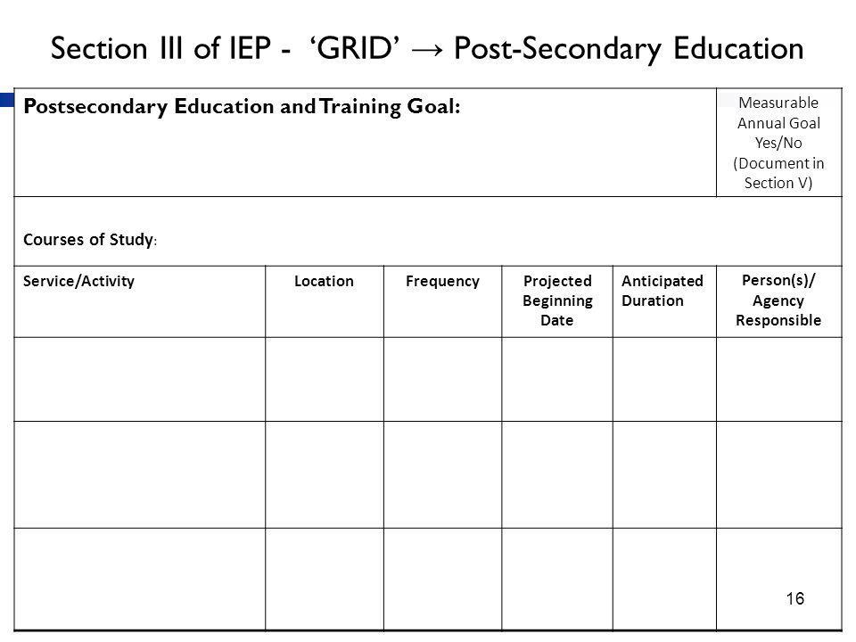
This is the Transition Grid

Slide 12
How do I come up with goals for my future?
Your special education teacher, transition coordinator, and/or guidance councilor will ask you to complete transition assessments every year
Transition assessments are like test but with these there are no wrong or right answers
Transition assessments come in many different forms and can include the following:
  Survey, interview, work samples, teacher questionnaire, person centered planning, aptitude/interest tests

Slide 13
Where can You start?
Here are some websites that you can explore:
Career Cluster Survey
https://careerwise.minnstate.edu/careers/clusterSurvey
PA CareerZone
https://www.pacareerzone.org/
Occupational Outlook Handbook
https://www.bls.gov/ooh/
O*Net OnLine
https://www.onetonline.org/
Mobile Transition Apps
https://www.pacer.org/transition/resource-library/publications/NPC-62.pdf

Slide 14

Post-Secondary Education & Training
In this part of the grid, you will develop a goal that is unique to you. Some examples of what you might find here include:
  2 or 4 year college, community college, postsecondary vocational program, licensing program, non-credit adult education class, adult training program
Within this section, you will have at least one activity and one services that will support you toward meeting your goal.
Activities – Action steps
Service – Improve your area(s) of need

Slide 15
Post-Secondary Education & Training Continued
Activities you will be working on are specific to your goal and can be grade specific; however below are some examples:
  Register SAT accommodations
  Develop time management or organization skills
  Contact disability services to self-identify
  Identify learning style
  Explore/visit schools of interest
  Practice self-advocacy skills

Slide 16

Employment
In this part of the grid, you will develop a goal that is unique to you. Some examples of what you might find here include:
  Sheltered, supported, military, competitive (ultimate goal if possible)
Within this section, you will have at least one activity and one services that will support you toward meeting your goal.

Slide 17
Employment Continued
Activities you will be working on are specific to your goal and can be grade specific; however below are some examples:
  Complete a job shadow in a career area of interest
  Practice filling out a job application
  Mock interview
  Complete a work based learning experience
  Research jobs of interest and discuss what accommodations you make need

Slide 18
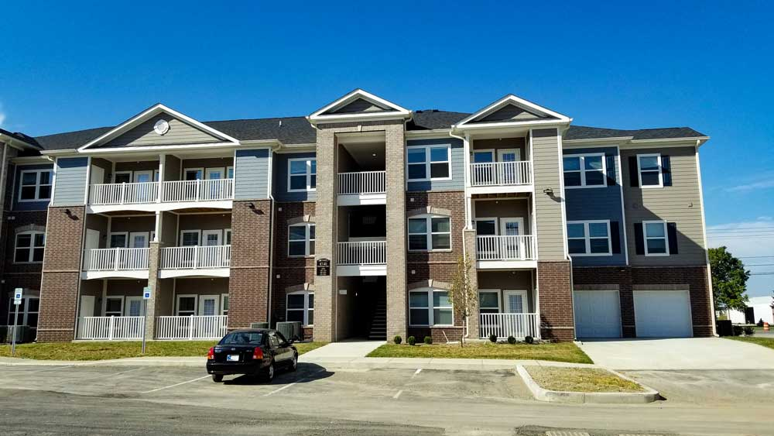
Independent Living
In this part of the grid, you will develop a goal that is unique to you. Some examples of what you might find here include:
  No support, family support, agency support
Within this section, you will have at least one activity and one services that will support you toward meeting your goal.

Slide 19
Independent living continued
Activities you will be working on are specific to your goal and can be grade specific; however below are some examples:
  Register to vote
  Verify healthcare coverage past 18
  Apply for driver’s license or state ID
  Create a list medications used and doctors that you see with contact information
  Investigate possible funding through Medicaid Waivers
  Food preparation
  Budgeting skills

Slide 20

Agency Support
Organizations that can support you in terms of supporting your needs in the areas of post-secondary education/training, employment, and independent living
Provide or pay for services
Many out there…knowing who that are and what they offer is important
Some are disability specific

Slide 21
What agencies are out there?
Office of Vocational Rehabilitation (OVR)
  https://www.dli.pa.gov/Individuals/Disability-Services/ovr/Pages/default.aspx
County Mental Health
  https://www.dhs.pa.gov/providers/Providers/Pages/County-Mental-Health-System.aspx
Center for Independent living
  https://cilcp.org/programs-services/
Department of Public Services (Bureau of Autism Services)/ODP
  https://www.dhs.pa.gov/contact/DHS-Offices/Pages/ODP-Bureau%20of%20Autism%20Services.aspx
Children and Youth Services
Juvenile Justice System

Slide 22


Youth Virtual Coffee drop-in
Every Thursday at 12:00 through the PEAL Center
30 minute virtual sessions
Relax and chat with other young people about secondary transition topics
Zoom Link – https://zoom.us/j/95790302310
View the topic for each week on the calendar – https://www.pealcenter.org/events

Slide 23
Transition Planning into reality
Visualization is a powerful tool but make sure you tell others
Dream big and set goals along the way (short and long term)
Don’t let yourself be your worst enemy – believe in yourself
Be resilient, never stop working for what you want, and never ever give up
Greatness takes time - be patient

Slide 24
Calling all Parents
- Local Task Force -
The local task force is a parent/family network group for families that have a child with a disability
The purpose of the meetings is to educate, network, communicate, and support one another through the special education maze
Meeting dates via Zoom (9:00 a.m. – 10:30 a.m.)
  Tuesday, October 27th 2020
  Wednesday, January 27th 2021
  Wednesday, March 31st 2021
  Wednesday, May 26th 2021
  https://www.tiu11.org/wp-content/uploads/2020/10/Local-Task-Force-Brochure-Updated-8-26-2020.pdf

Slide 25

Questions?

